Slide 1


Introduction to Water Chemistry & Hardness
Course Code: ETMLCH104
Course Name: Engineering Chemistry
Program: B.Tech. (AI/ML)
Unit 3: Battery Technology
Dr. Mehak Ahuja
Assistant Professor, Department of Chemistry
School of Basic and Applied Sciences
K.R. Mangalam University
Sohna Road, Gurugram

Slide 2

Course Overview
UNIT WISE DETAILS ​ ​ ​
Unit Number: 1 ​ | Title: Water technology ​ | No. of hours: 6 ​
Content Summary: ​ Introduction, water analysis: Hardness-determination by EDTA method, Treatment of boiler feed water: Internal treatment (Phosphate, Colloidal and Calgon conditioning). External treatments: Ion exchange and lime-soda process, Zeolite processes. Boiler scales formation and ill effects, methods of prevention of scales. Numerical problems ​
Unit Number: 2 ​ | Title: Chemical Fuels ​ | No. of hours: 9 ​
Content Summary: ​ Fuels: Introduction, classification, calorific value (HCV & LCV), Determination of calorific value of fuel using Bomb calorimeter. ​ Solid fuel: Coal- its analysis by proximate and ultimate analysis, Numerical problems. ​ Liquid fuels: Refining of petroleum, Petroleum cracking, Knocking in IC engine, its ill effects and prevention of knocking. Anti-knocking agent: Leaded and unleaded petrol. ​ Gaseous fuels: LPG, CNG and their applications. ​
Unit Number: 3 ​ | Title: Battery Technology ​ | No. of hours: 10 ​
Content Summary: ​ Introduction - Galvanic cell, electrode potential, EMF of the cell and cell representation. Batteries and their importance, Classification of batteries- primary, secondary and reserve batteries with examples. Battery characteristics - voltage, capacity, energy density, power density, energy efficiency, cycle life and shelf life. ​ Construction, working and applications of: Ni-Cd, and Lithium-ion battery. Working principle of an electric vehicle. ​
Unit Number: 4 ​ | Title: Polymer ​ | No. of hours: 5 ​
Content Summary: ​ Basic concepts of polymer, Types of polymers, Thermoplastic & thermosetting plastics, Preparation and application of some industrially important polymers (Natural rubber, Buna S, Buna-N, Neoprene, Isoprene, Nylon-6, nylon-6,6 , Decron and Terylene). Conducting and biodegradable polymers. ​

Slide 3
COURSE OUTCOMES
CO1: Understand the methods for water hardness and the basics of boiler water treatment and analyze fuel calorific values and battery.
CO2: Explain the characteristics and working principles of different battery types and types of fuels.
CO3: Determine the differences between batteries and fuel cells and classify fuel cell types based on their components..
CO4: Identify between hard and soft water, solve the related numerical problems on water purification and emf and its significance in industry and daily life.

Slide 4
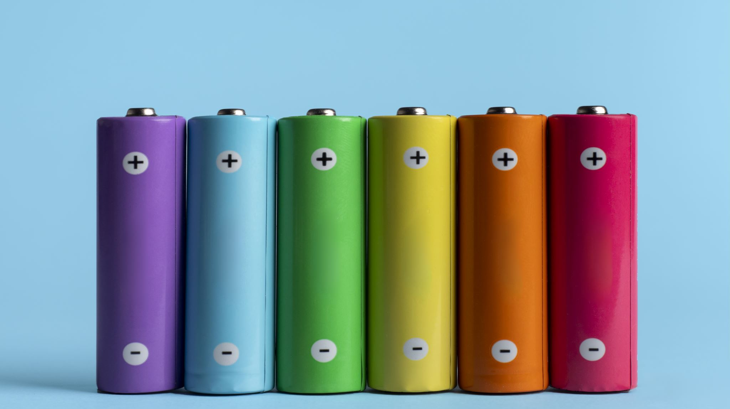
Battery Technology
Introduction - Galvanic cell, electrode potential, EMF of the cell and cell representation.

Slide 5


Electrochemical cells
Electrochemical cells are devices that convert chemical energy into electrical energy or vice versa.
Galvanic cells (also called voltaic cells) are electrochemical cells that produce electrical energy from a spontaneous redox reaction.
Electrode potential is the tendency of an electrode to lose or gain electrons.
EMF (electromotive force) is the maximum potential difference between two electrodes of a galvanic cell when no current is flowing.
Cell representation is a shorthand way of representing a galvanic cell, showing the electrodes, electrolyte, and direction of electron flow.
Notes:
New Courses replaced with New Programmes

Slide 6
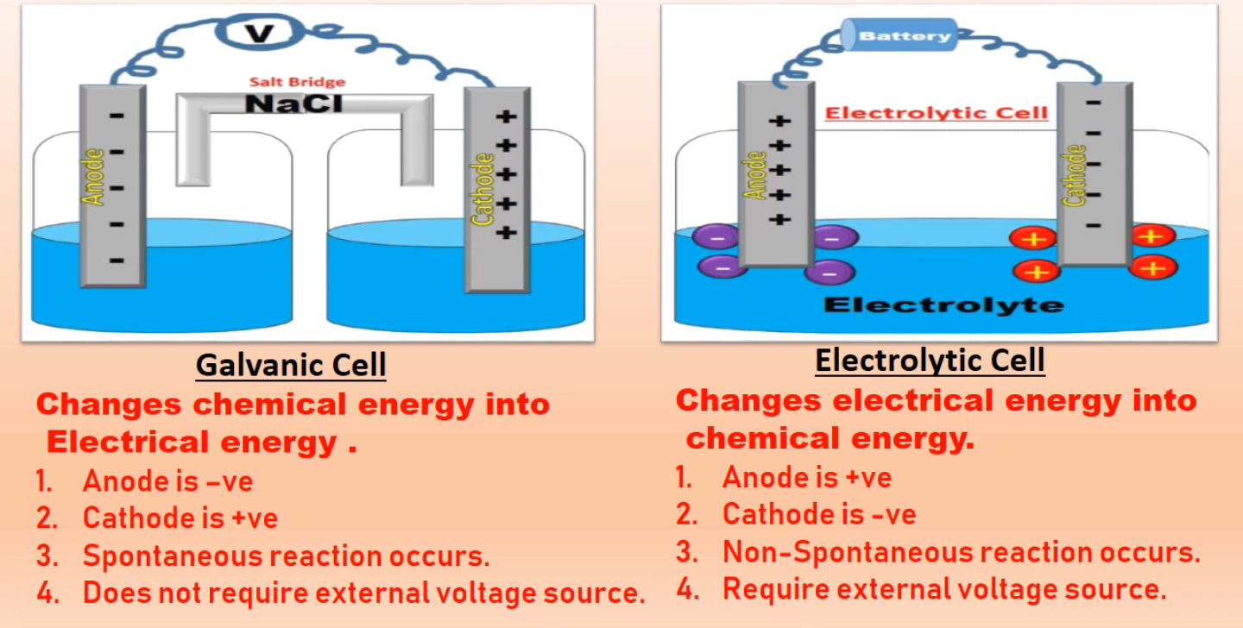
Difference between Galvanic cell and Electrolytic cell
Fig 1 : Galvanic cell and electrolytic cell

Slide 7
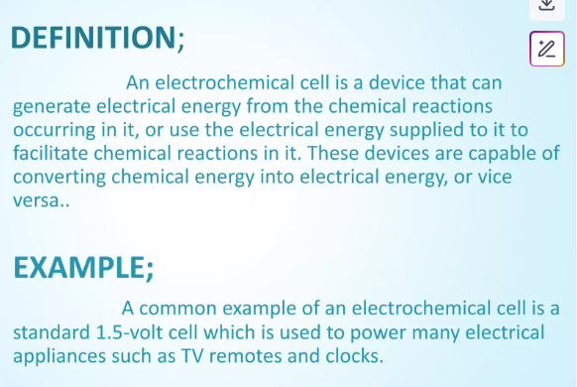
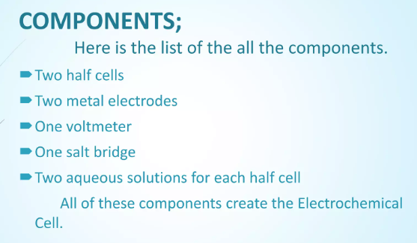

Slide 8
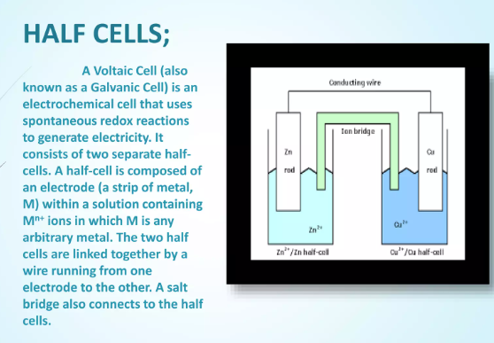
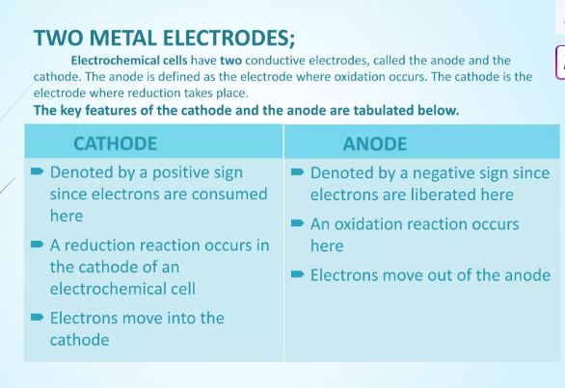

Slide 9
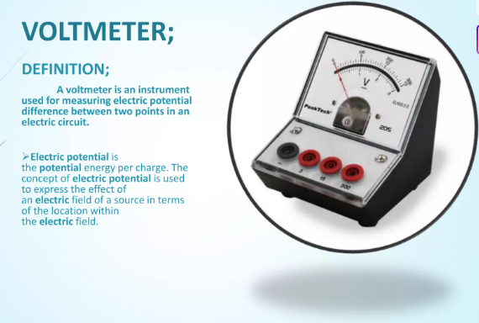

Slide 10
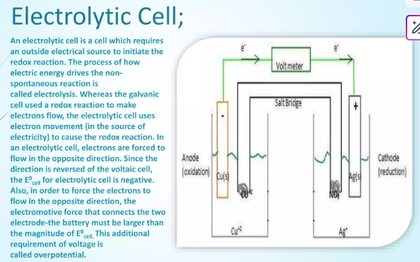

Slide 11
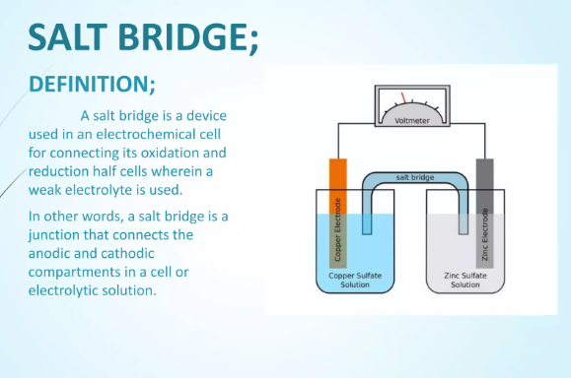
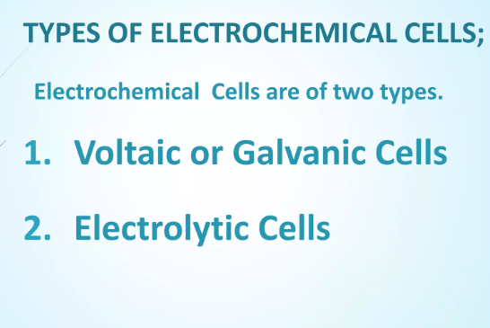

Slide 12
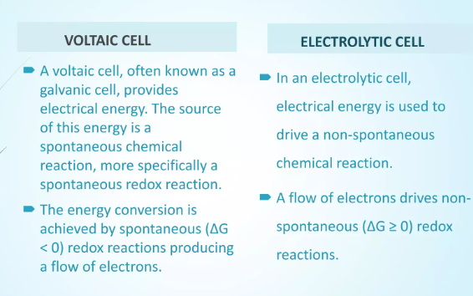

Slide 13
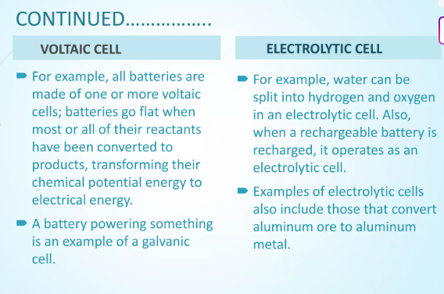

Slide 14
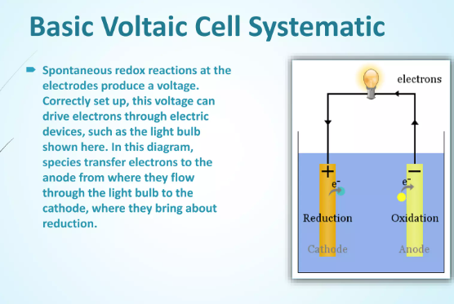
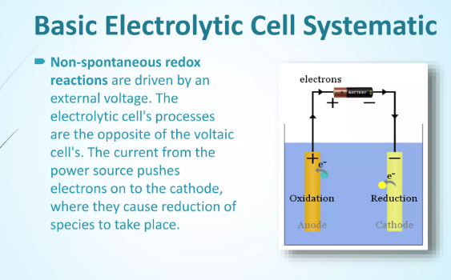

Slide 15
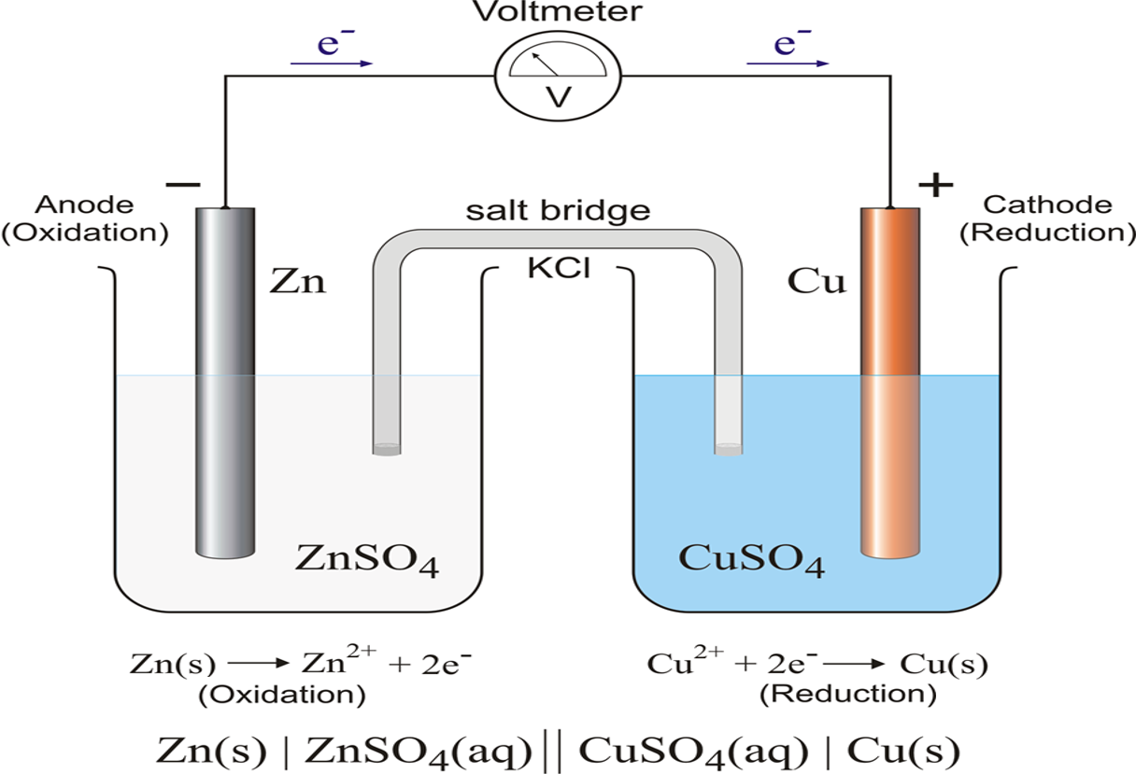
Galvanic cell diagram
Fig 2 : Galvanic cell representation
Notes:
New Courses replaced with New Programmes

Slide 16
Example:
Write the half-cell reaction and the overall cell reaction for the electrochemical cell: Zn | Zn ²⁺ (1.0M) || Pb ²⁺ (1.0M) | Pb
Calculate the standard e.m.f for the cell if standard electrode potential (reduction) for Pb ²⁺ | Pb and Zn ²⁺ | Zn electrodes are – 0.126 V and – 0.763 V respectively.
Zn electrode acts as anode
Pb electrode acts as cathode
And therefore , oxidation occurs at zinc electrode and reduction occurs at lead electrode.
The half cell reactions are : Oxidation half reaction : Zn(s)→Zn²⁺(aq)+2e⁻ Reduction half reaction : Pb²⁺(aq)+2e⁻ →Pb(s)
Overall cell reaction : Zn (s) +Pb²⁺(aq)→Zn²⁺(aq) + Pb(s) Eº_{cell}= Eº_{R}−Eº_{L} = −0.126−(−0.763) =0.637 V
Notes:
New Courses replaced with New Programmes

Slide 17
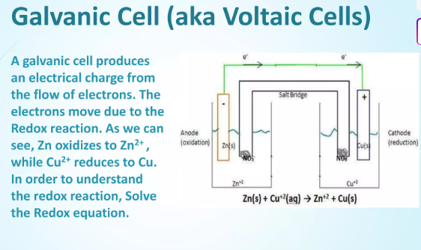
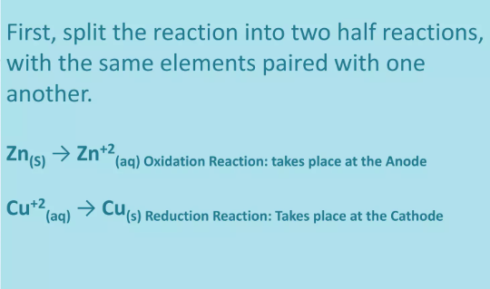
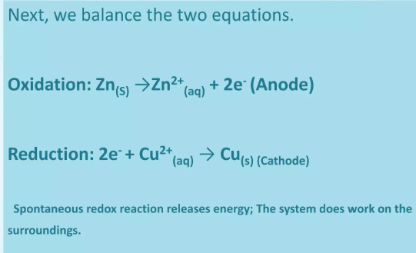

Slide 18
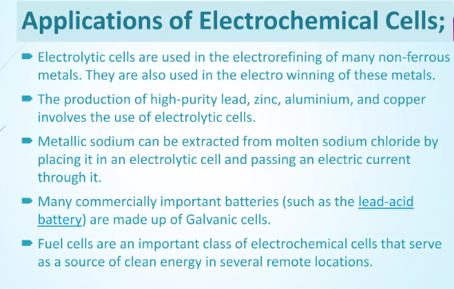

Slide 19
Take away of the session
Definition: A battery is a device that stores chemical energy and converts it into electrical energy through electrochemical reactions.
Types of Batteries:
Primary Batteries: Non-rechargeable (e.g., dry cell, alkaline battery)
Secondary Batteries: Rechargeable (e.g., lead-acid, lithium-ion, nickel-cadmium)
Key Components:
Anode (negative electrode)
Cathode (positive electrode)
Electrolyte (medium for ion flow)
Important Parameters:
Voltage, capacity (mAh/Ah), cycle life, energy density, charging time
Applications: Widely used in electronics, EVs, power backup systems, and renewable energy storage.

Slide 20
Questions
1. Which of the following batteries is rechargeable? A. Alkaline battery B. Dry cell C. Lead-acid battery D. Zinc-carbon battery ✅ Answer: C
2. What is the function of the electrolyte in a battery? A. Stores electricity B. Prevents short circuit C. Allows ion flow between electrodes D. Insulates the electrodes ✅ Answer: C
3. Which of the following is a primary battery? A. Nickel-cadmium battery B. Lead-acid battery C. Lithium-ion battery D. Zinc-carbon battery ✅ Answer: D
4. What does “mAh” (milliampere-hour) indicate in a battery? A. Voltage rating B. Power consumption C. Battery capacity D. Resistance ✅ Answer: C
5. Lithium-ion batteries are widely used in: A. Flashlights B. Mobile phones and laptops C. Remote controls D. Emergency lamps only ✅ Answer: B

Slide 21
Learning Outcomes
CO1: Understand the methods for water hardness and the basics of boiler water treatment and analyze fuel calorific values and battery.
CO2: Explain the characteristics and working principles of different battery types and types of fuels.
BTL-1: Recall definitions and types of electrochemical cells and batteries (CO1, CO2)
BTL-2: Explain the construction and characteristics of batteries and galvanic cells (CO1, CO2)
BTL-3: Apply EMF calculation methods and relate them to real battery examples (CO1)
BTL-4: Analyze the differences between galvanic and electrolytic cells (CO2)
Mapped Course Outcomes

Slide 22
References
Engineering Chemistry by Jain and Jain.

